Slide 1
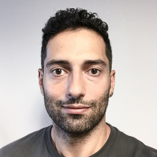

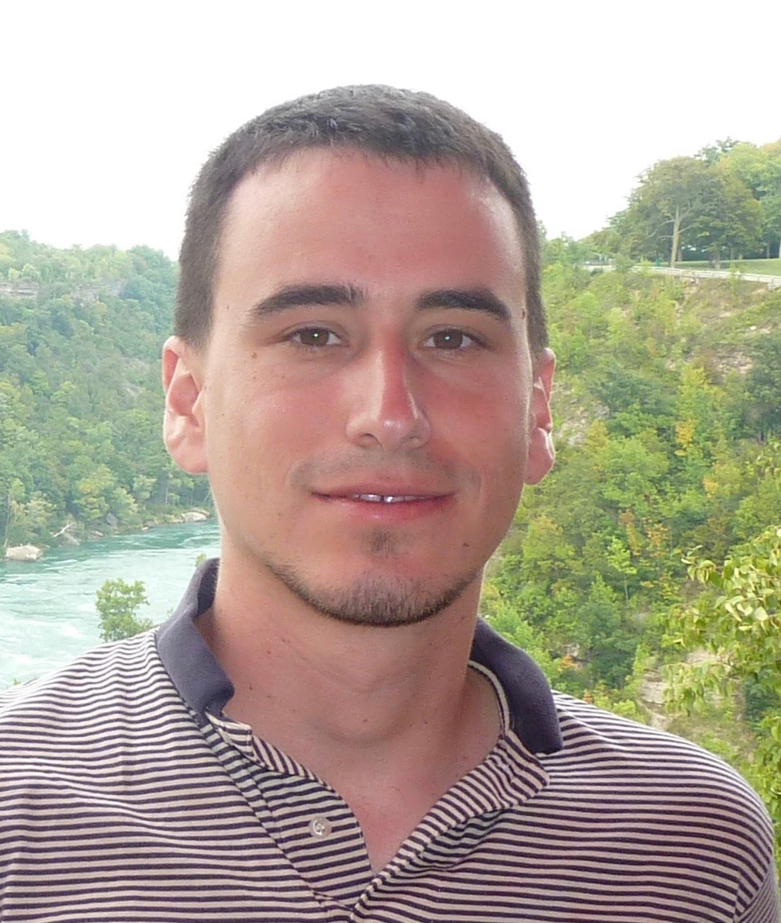
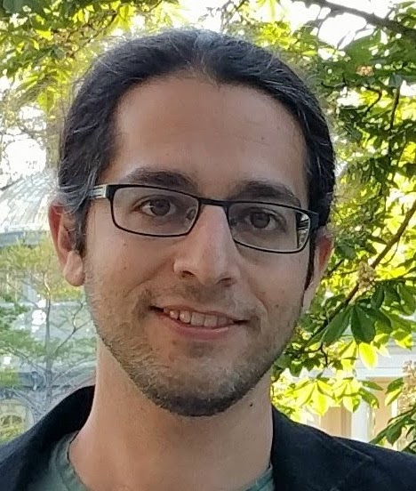
Fooling Constant-Depth Threshold Circuits
TCS+
February 17, 2021
Pooya Hatami¹
Ohio State University
pooyahat@gmail.com
William M. Hoza²
UT Austin
whoza@utexas.edu
Avishay Tal
UC Berkeley
atal@berkeley.edu
Roei Tell
MIT
roei.tell@gmail.com
¹Supported by NSF grant CCF-1947546.
²Supported by the NSF GRFP under Grant DGE-1610403 and by a Harrington Fellowship from UT Austin.

Slide 2
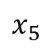

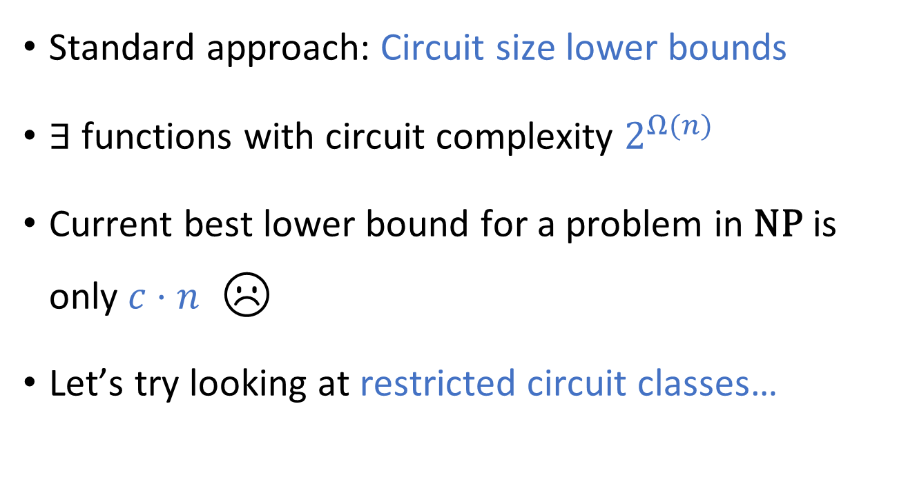
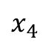




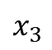

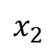


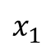
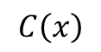

How to prove $\text{P}≠\text{NP}$?
$$C\left(x\right)$$
$$∧$$
Standard approach: Circuit size lower bounds
$∃$ functions with circuit complexity $2^{Ω(n)}$
Current best lower bound for a problem in $\text{NP}$ is only $c⋅n$ ☹️
Let’s try looking at restricted circuit classes…
$$∨$$
$$∨$$
$$∨$$
$$∨$$
$$∧$$
$$∧$$
$$∧$$
$$x_{1}$$
$$x_{2}$$
$$x_{3}$$
$$x_{4}$$
$$x_{5}$$

Slide 3


Lower bounds for ${\text{AC}}^{0}$
(Constant-depth circuits)
😁 Exponential size lower bounds
[Ajtai 1983, FSS 1984, Yao 1985, Håstad 1986]
✔️ Average-case
[Ajtai 1983, FSS 1984, Yao 1985, Håstad 1986, BIS 2012, IMP 2012, Håstad 2014]
✔️ Pseudorandom generators
[AW 1985, Nisan 1991, Braverman 2009, TX 2013, Tal 2017, HS 2019, ST 2019, Kelley 2020]

Slide 4
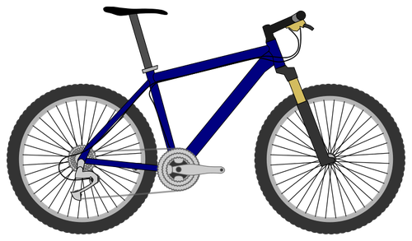

A more challenging class: ${\text{TC}}^{0}$

Slide 5
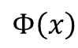
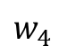
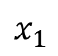
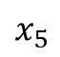
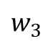
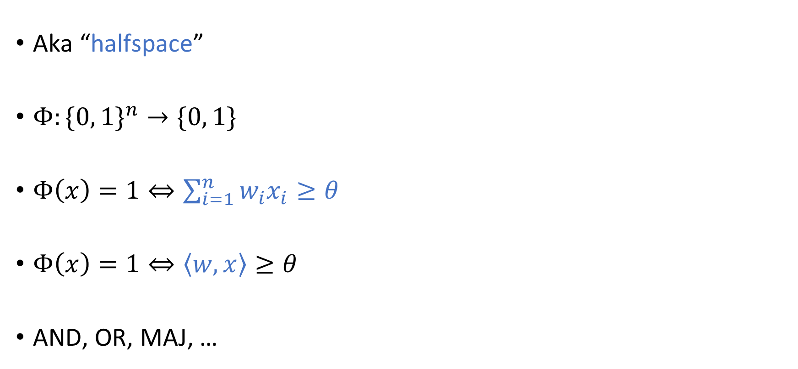
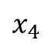
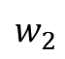
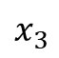
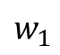
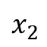

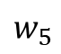
Linear threshold functions (LTFs)
$$Φ\left(x\right)$$
Aka “halfspace”
$Φ:\{0, 1\}^{n}→\{0, 1\}$
$Φ\left(x\right)=\text{1}⇔\sum_{i=1}^{n}{w_{i}x_{i}≥θ}$
$Φ\left(x\right)=1⇔\left\langle w,x\right\rangle ≥θ$
AND, OR, MAJ, …
$$∑$$
$$w_{1}$$
$$w_{5}$$
$$w_{2}$$
$$w_{4}$$
$$w_{3}$$
$$x_{1}$$
$$x_{2}$$
$$x_{3}$$
$$x_{4}$$
$$x_{5}$$

Slide 6
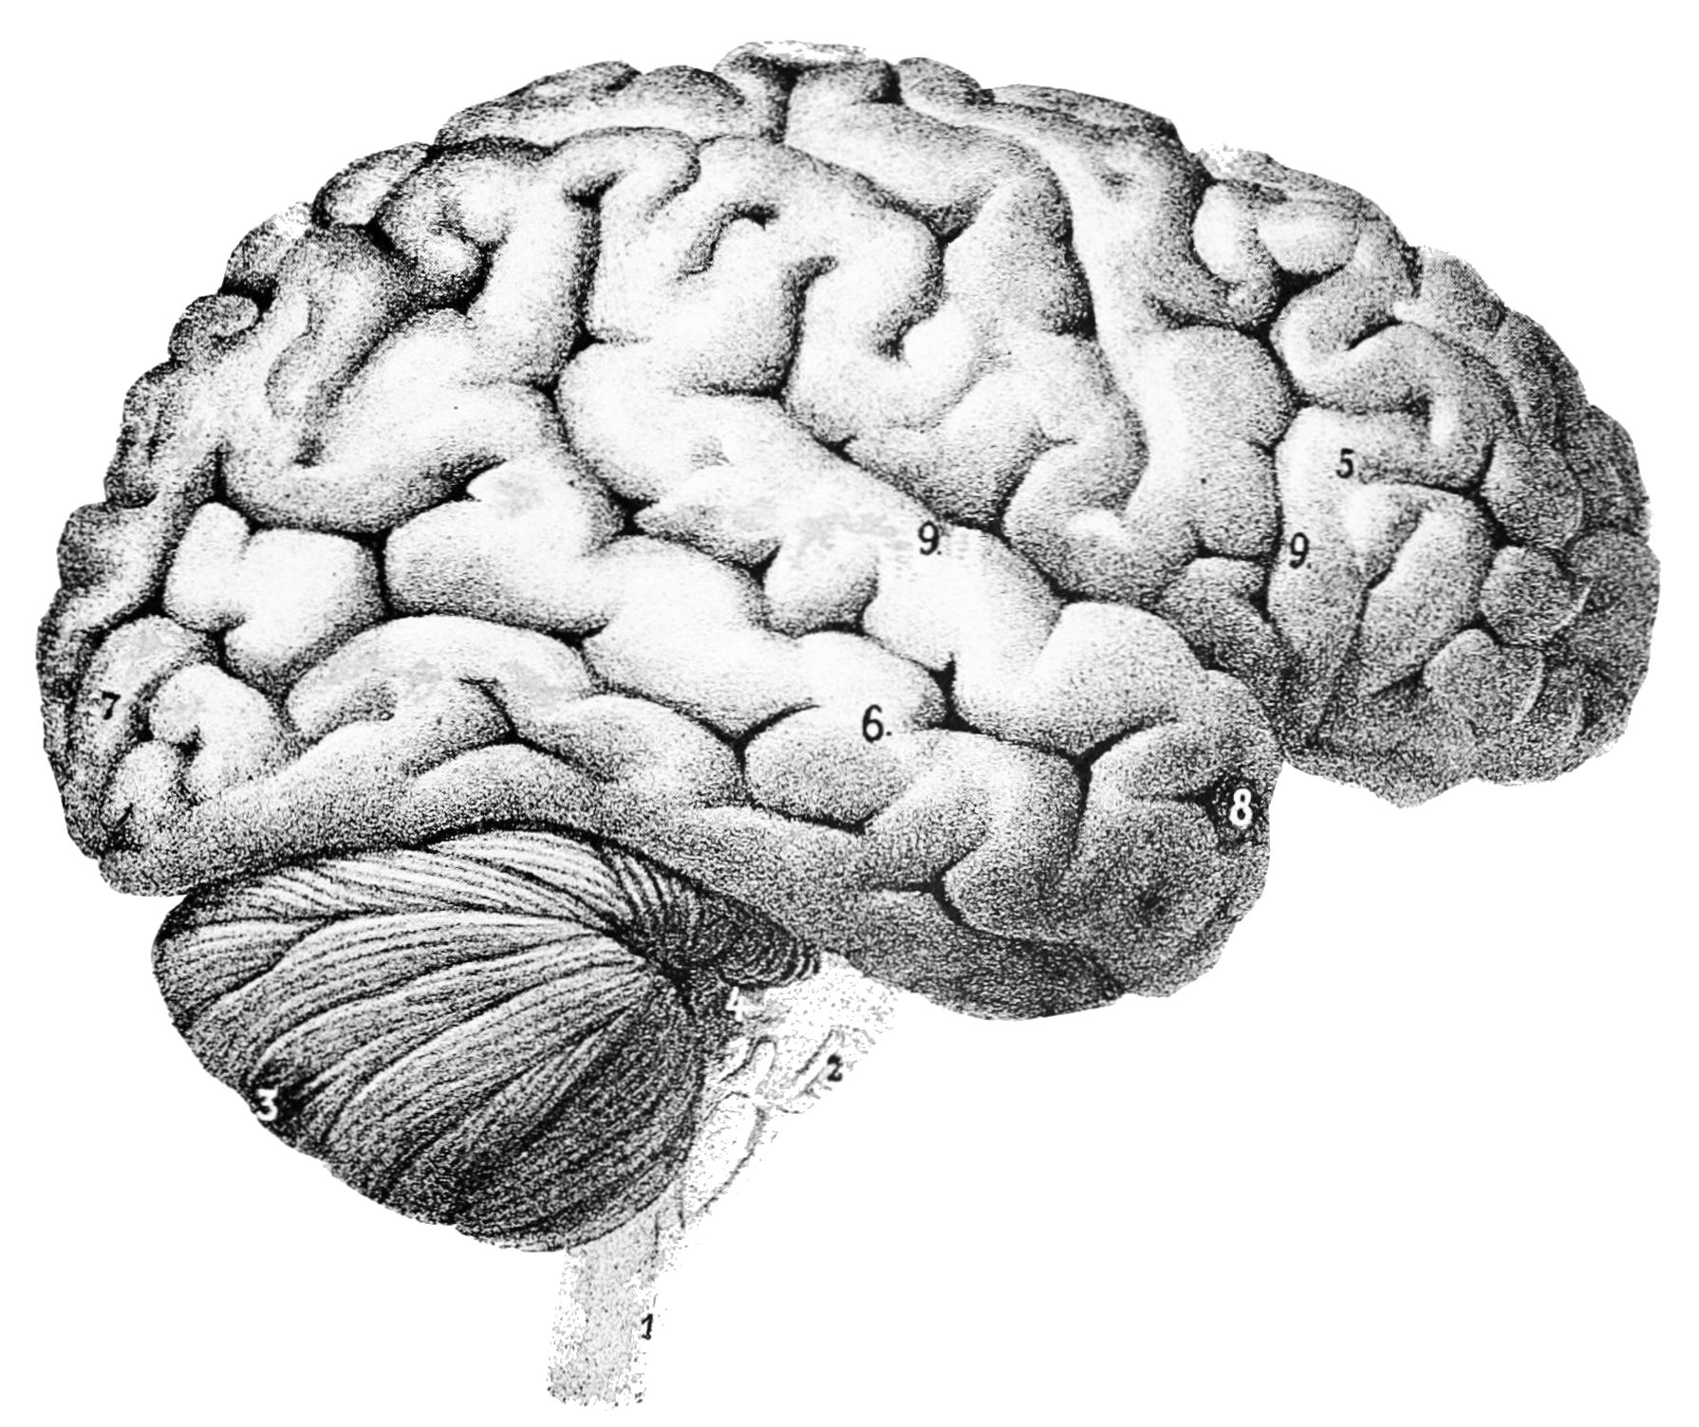
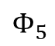
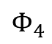
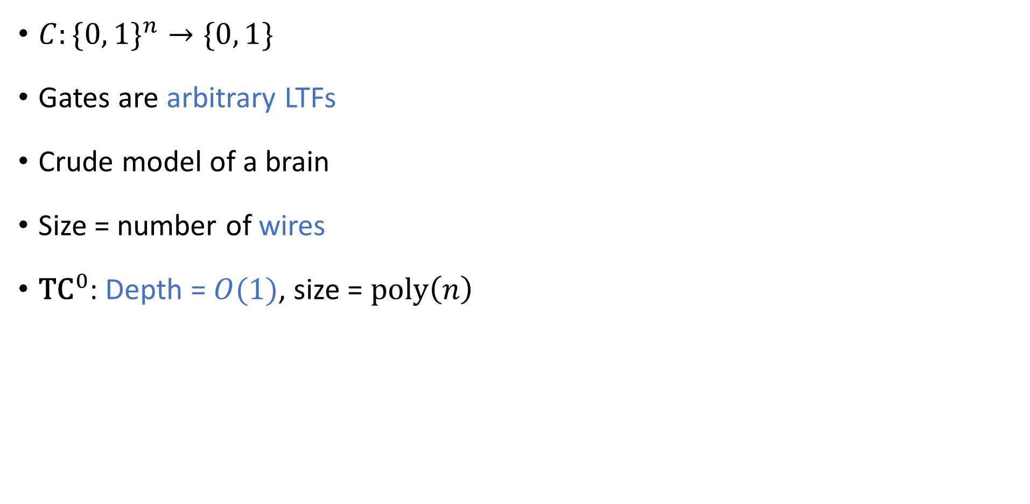
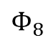
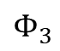
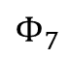
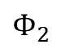
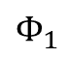
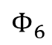
LTF circuits
$$C\left(x\right)$$
$C:\{0, 1\}^{n}→\{0, 1\}$
Gates are arbitrary LTFs
Crude model of a brain
Size = number of wires
${\text{TC}}^{0}$: Depth = $O(1)$, size = $\text{poly}\left(n\right)$
$$Φ_{8}$$
$$Φ_{4}$$
$$Φ_{5}$$
$$Φ_{6}$$
$$Φ_{7}$$
$$Φ_{1}$$
$$Φ_{2}$$
$$Φ_{3}$$
$$x_{1}$$
$$x_{2}$$
$$x_{3}$$
$$x_{4}$$
$$x_{5}$$

Slide 7
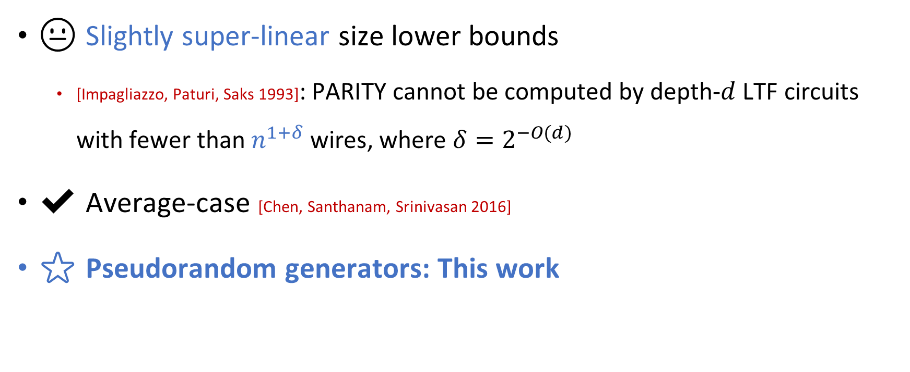

Lower bounds for ${\text{TC}}^{0}$
😐 Slightly super-linear size lower bounds
[Impagliazzo, Paturi, Saks 1993]: PARITY cannot be computed by depth-$d$ LTF circuits with fewer than $n^{1+δ}$ wires, where $δ=2^{−O(d)}$
✔️ Average-case [Chen, Santhanam, Srinivasan 2016]
⭐ Pseudorandom generators: This work

Slide 8


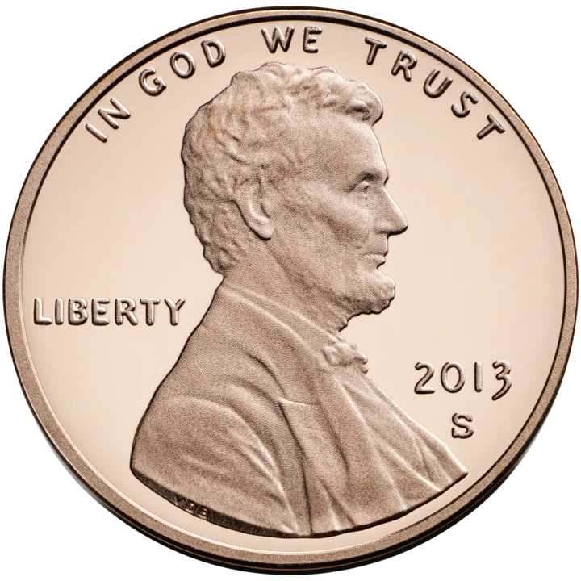

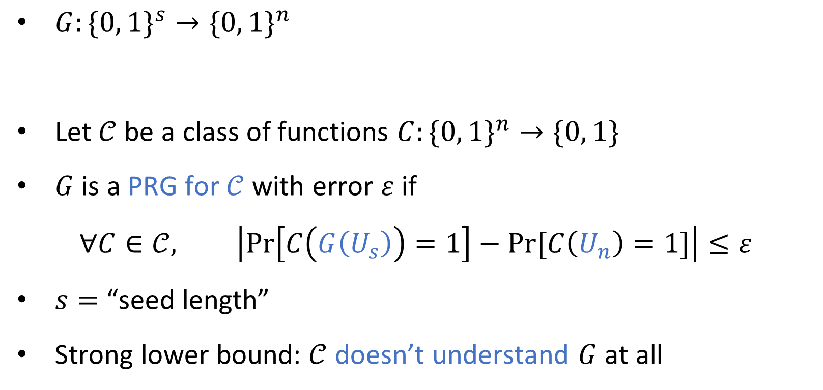
Pseudorandom generators (PRGs)
$G:\{0, 1\}^{s}→\{0, 1\}^{n}$
Let $𝒞$ be a class of functions $C:\{0, 1\}^{n}→\{0, 1\}$
$G$ is a PRG for $𝒞$ with error $ε$ if
$$∀C∈𝒞, \left|\operatorname{Pr}\left[C\left(G\left(U_{s}\right)\right)=1\right]−Pr⁡[C\left(U_{n}\right)=1]\right|≤ε$$
$s=$ “seed length”
Strong lower bound: $𝒞$ doesn’t understand $G$ at all

Slide 9
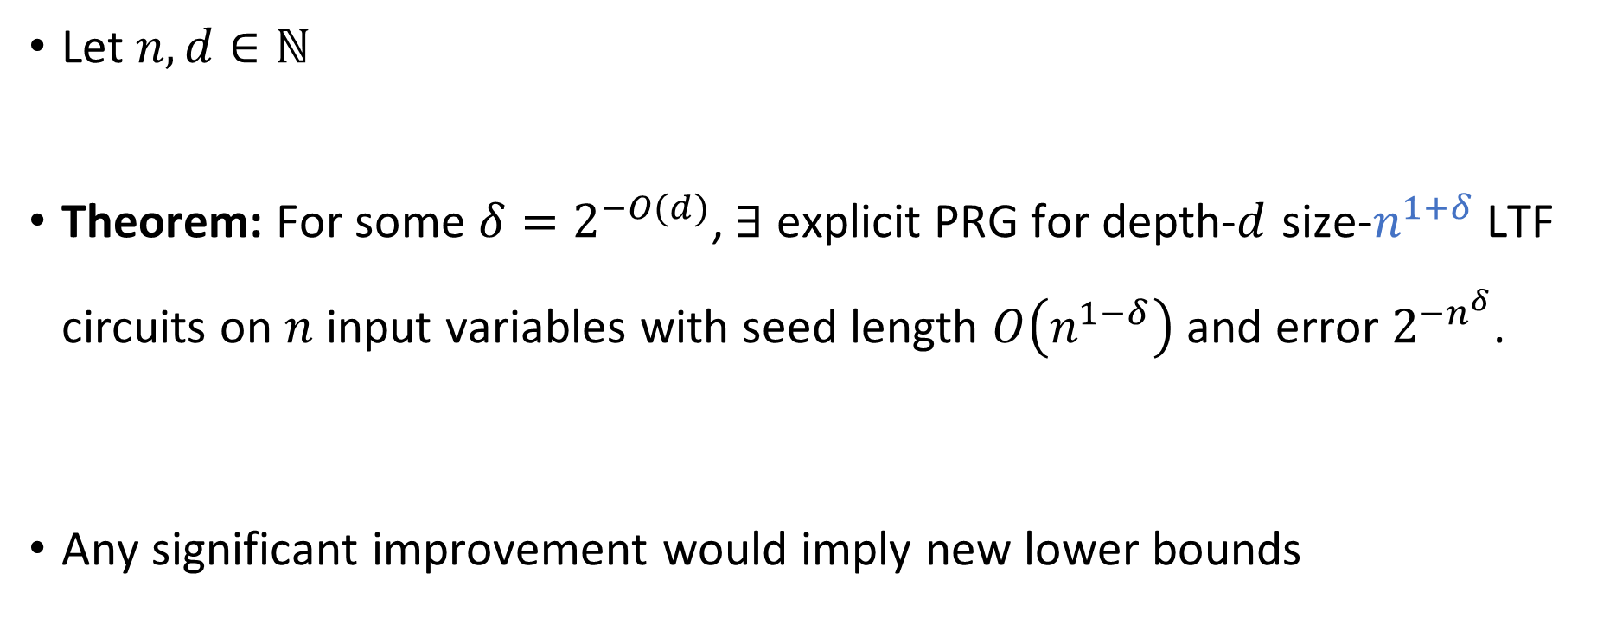
PRGs for LTF circuits
Size = number of wires
Let $n, d∈ℕ$
Theorem: For some $δ=2^{−O(d)}$, $∃$ explicit PRG for depth-$d$ size-$n^{1+δ}$LTF circuits on $n$ input variables with seed length $O\left(n^{1−δ}\right)$ and error $2^{−n^{δ}}$.
Any significant improvement would imply new lower bounds

Slide 10
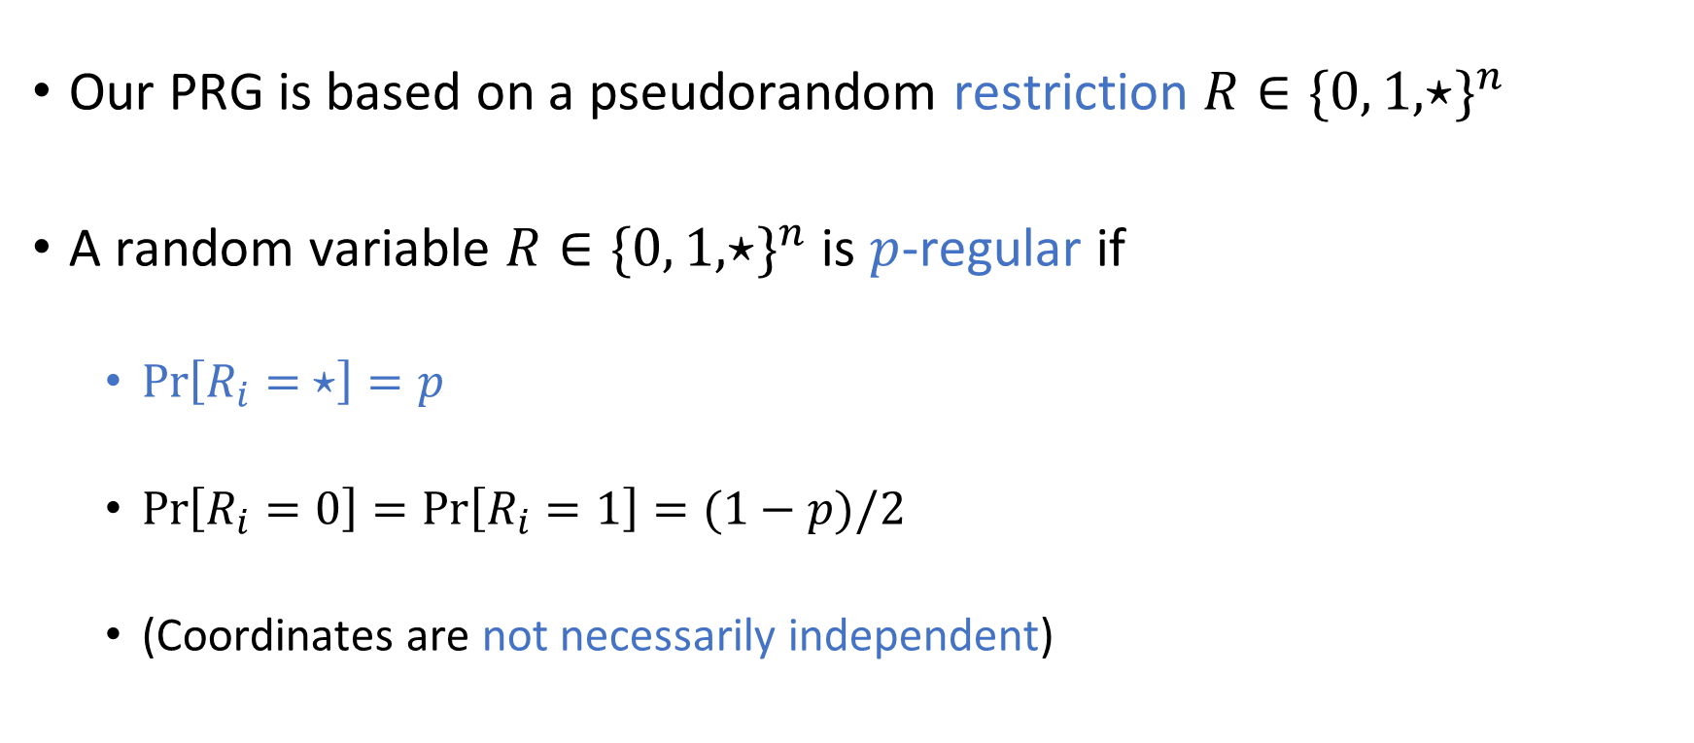
Restrictions
Our PRG is based on a pseudorandom restriction $R∈\{0, 1, ⋆\}^{n}$
A random variable $R∈\{0, 1, ⋆\}^{n}$ is $p$-regular if
$\operatorname{Pr}\left[R_{i}= ⋆\right]=p$
$\operatorname{Pr}\left[R_{i}=0\right]=\operatorname{Pr}\left[R_{i}=1\right]=(1−p)/2$
(Coordinates are not necessarily independent)

Slide 11
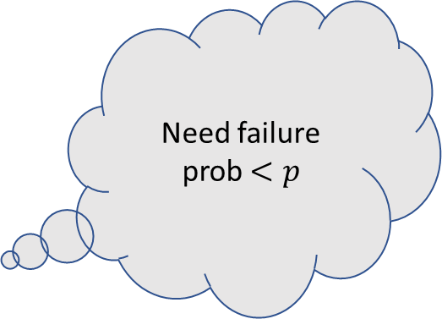
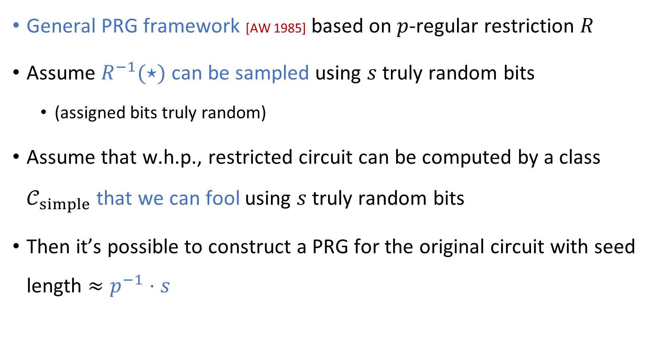
Ajtai-Wigderson framework
General PRG framework [AW 1985] based on $p$-regular restriction $R$
Assume $R^{−1}(⋆)$ can be sampled using $s$ truly random bits
(assigned bits truly random)
Assume that w.h.p., restricted circuit can be computed by a class $𝒞_{simple}$ that we can fool using $s$ truly random bits
Then it’s possible to construct a PRG for the original circuit with seed length $≈p^{−1}⋅s$
Need failure prob $<p$

Slide 12
Overview
Show that LTF circuits simplify under pseudorandom restrictions
Fool the simplified model

Slide 13
Overview
Show that LTF circuits simplify under pseudorandom restrictions
Fool the simplified model

Slide 14
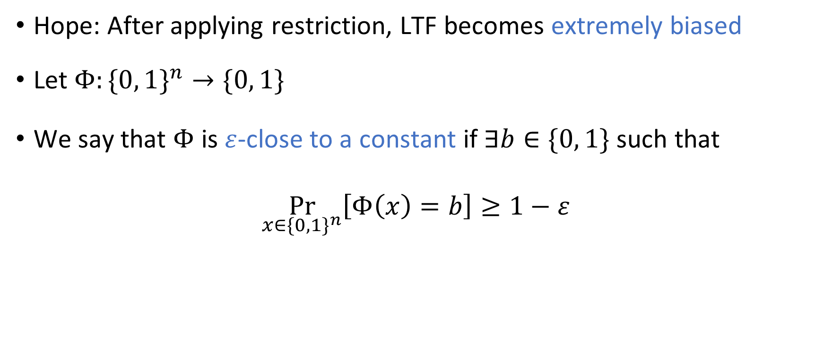
Simplification of a single gate
Hope: After applying restriction, LTF becomes extremely biased
Let $Φ:\{0, 1\}^{n}→\{0, 1\}$
We say that $Φ$ is $ε$-close to a constant if $∃b∈\{0, 1\}$ such that
$$\underset{x∈\{0, 1\}^{n}}{Pr}\left[Φ\left(x\right)=b\right]≥1−ε$$

Slide 15
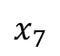
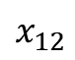

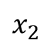

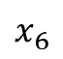
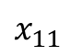
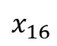
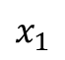
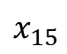

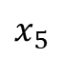









MAJ becomes biased under restrictions
$$x_{1}$$
$$x_{2}$$
$$x_{3}$$
$$x_{4}$$
$$x_{5}$$
$$x_{6}$$
$$x_{7}$$
$$x_{8}$$
$$x_{9}$$
$$x_{10}$$
$$x_{11}$$
$$x_{12}$$
$$x_{13}$$
$$x_{14}$$
$$x_{15}$$
$$x_{16}$$
$$x_{17}$$
0
1
$$⋆$$
$$⋆$$
1
1
$$⋆$$
0
1
0
0
$$⋆$$
1
1
0
1
1

Slide 16




MAJ becomes biased under restrictions
0
0
0
0
0
1
1
1
1
1
1
1
1
$$⋆$$
$$⋆$$
$$⋆$$
$$⋆$$

Slide 17




MAJ becomes biased under restrictions
Let $R$ be a truly random restriction with $\left|R^{−1}\left(⋆\right)\right|=pn$
Claim: $\operatorname{Pr}\left[\text{MAJ}{\left.​\right|}_{R} \text{is} \text{not} ε\text{−}\text{close} \text{to} \text{a} \text{constant}\right]≤O\left(\sqrt{p\log\left(1/ε\right)}\right)$
Proof step 1: Anti-concentration: For $Δ≥1$,
$$\underset{R}{Pr}\left[\left|\left(\text{\# }\text{ones} \text{in} R\right)−\frac{\left(1−p\right)n}{2}\right|≤Δ\right]≤O\left(Δ/\sqrt{n}\right) \text{(}\text{max} \text{binomial} \text{coefficient}\text{)}$$
Proof step 2: Concentration:
$$\underset{x∈\{0, 1\}^{R^{−1}\left(⋆\right)}}{Pr}\left[\left|\left(\text{\# }\text{ones} \text{in} x\right)−\frac{pn}{2}\right|≥Δ\right]≤\exp\left(−Ω\left(\frac{Δ^{2}}{pn}\right)\right) \text{(}\text{Hoeffding}\text{)}$$
$$O\left(\sqrt{p\log\left(1/ε\right)}\right)$$
$$Δ=\sqrt{pn⋅log⁡(1/ε)}$$
$$ε$$

Slide 18

LTFs become biased under restrictions
Let $R$ be a truly random $p$-regular restriction and let $Φ$ be an LTF
Thm [CSS 2016]: $\operatorname{Pr}\left[Φ{\left.​\right|}_{R} \text{is} \text{not} ε\text{−}\text{close} \text{to} \text{a} \text{constant}\right]≤p^{Ω\left(1\right)}⋅\log\left(1/ε\right)$
*Actually we rely on a more technical variant of this result, where:
$R^{−1}\left(⋆\right)$ is a pseudorandom subset of $[n]$…
…with largest-weight variables excluded (non-black-box)
$\operatorname{Pr}\left[\text{bad} \text{assigned} \text{bits}\right]=p^{Ω(1)}$, but $\operatorname{Pr}\left[\text{bad} \text{stars}\right]=ε≪p$
For talk, ignore these technicalities (see paper if curious)

Slide 19









Simplification of LTF circuits
$$C\left(x\right)$$
$$Φ_{8}$$
Hope: Use a (pseudo)random restriction to collapse bottom layer
Most gates will become $ε$-close to constants
Replace them with constants
Difficulty: Some gates will not become extremely biased ($\operatorname{Pr}\left[\text{fail}\right]≫p$)
$$Φ_{4}$$
$$Φ_{5}$$
$$Φ_{6}$$
$$Φ_{7}$$
$$Φ_{1}$$
$$Φ_{2}$$
$$Φ_{3}$$
$$x_{1}$$
$$x_{2}$$
$$x_{3}$$
$$x_{4}$$
$$x_{5}$$

Slide 20
















LTF decision trees (LTF-DTs)
Solution: Versatile model $𝒞_{simple}$
Decision tree that can query variables or LTFs, with LTF circuits at leaves
[Chen, Santhanam, Srinivasan 2016]
$$x_{1}$$
$$Φ_{1}(x)$$
$$Φ_{2}(x)$$
$$x_{3}$$
$$x_{6}$$
$$x_{2}$$
$$x_{3}$$
$$C_{1}\left(x\right)$$
$$C_{2}\left(x\right)$$
$$C_{3}\left(x\right)$$
$$C_{4}\left(x\right)$$
$$C_{5}\left(x\right)$$
$$C_{6}\left(x\right)$$
$$C_{7}\left(x\right)$$
$$C_{8}\left(x\right)$$

Slide 21


Slide 22



LTF circuit depth-reduction lemma
Let $C$ be a depth-$d$ LTF circuit with $w$ wires
Let $R$ be a $p$-regular restriction
$\left(p^{−1}\log\left(w/ε\right)\right)$-wise independent $⋆$ positions and truly random assigned bits
Lemma: With probability $1−ε$, $C{\left.​\right|}_{R}$ can be $ε$-approximated by LTF-DT where
Leaves are labeled with depth-$(d−1)$ LTF circuits with $≤w$ wires
# variable queries $≤O\left(\left(p^{7/6}⋅w+p^{−4}\right)⋅\log^{2}\left(w/ε\right)\right)$
# LTF queries $≤O(p^{−2})$
$$p=1/n^{0.001}$$
$$p^{7/6}⋅w≪p⋅n$$

Slide 23
General technique
Whenever some “bad event” occurs…
Query whoever is responsible for the bad event
That way, the problematic parts of the circuit can be replaced with constants

Slide 24

















Proof cases
$$Φ_{1}$$
$$Φ_{2}$$
$$Φ_{3}$$
“Heavy gates”: Fan-in $≥p^{−5/6}$
Vs. “light gates”
“Heavy variables”: Fan-out $≥p^{−7/6}$
Vs. “light variables”
$$x_{1}$$
$$x_{2}$$
$$x_{3}$$
$$x_{4}$$
$$x_{5}$$
$$Φ_{1}$$
$$Φ_{2}$$
$$Φ_{3}$$
$$x_{1}$$
$$x_{2}$$
$$x_{3}$$
$$x_{4}$$
$$x_{5}$$

Slide 25

Heavy gates & light variables
Let $m=\text{fan}\text{-}\text{in} \text{of} \text{each} \text{gate}≥p^{−5/6}$ (assume same $m$ for all gates, for simplicity)
Theorem $⇒$ each gate becomes extremely biased except with prob $≈p^{1/3}$
$𝔼\left[\text{\# }\text{somewhat}\text{−}\text{balanced} \text{gates}\right]≲p^{1/3}⋅\left(\text{\# }\text{gates}\right)≤p^{1/3}⋅w/m$
If total # gates$≲p^{−2}$, query the somewhat-balanced gates
Otherwise, query the variables feeding into the somewhat-balanced gates
W.h.p., each gate has $O\left(p⋅m+\log\left(w/ε\right)\right)$ living variables
$$𝔼\left[\text{\# }\text{variable} \text{queries}\right]≤O\left(\left(p⋅m+\log\left(w/ε\right)\right)⋅𝔼\left[\text{\# }\text{somewhat}\text{-}\text{balanced} \text{gates}\right]\right) \\ ≤O\left(\left(p^{4/3}⋅w+p^{7/6}⋅w\right)⋅\log\left(w/ε\right)\right)$$
Concentration: “Read-$k$ Chernoff Bound” [GLSS 2015] (light variables!)
✔️

Slide 26





Light gates & light variables
$$Φ_{1}$$
Fan-in $≤p^{−5/6}$
Hope: After restriction, fan-in $≤1$
“Connected pair”: Two variables feeding into same light gate
LTF-DT queries all variables in connected pairs where both survive
$𝔼\left[\text{\# }\text{queries}\right]≤2p^{2}⋅\left(\text{\# }\text{connected} \text{pairs}\right)≤{2p}^{2}⋅w⋅p^{−5/6}=2p^{7/6}⋅w$ ✔️
Concentration: Find many gates that don’t share variables. Independent events
$$⋆$$
$$0$$
$$⋆$$

Slide 27

Heavy variables
Fan-out $≥p^{−7/6}$
LTF-DT queries all heavy variables
So # queries $≤p^{7/6}⋅w$ ✔️

Slide 28

Iterating
So far: Under restriction,
Depth-$d$ LTF circuit $⇒$ LTF-DT with depth-$(d−1)$ LTF circuits at leaves
How to get down to depth $d−2$?

Slide 30


LTF-DT circuit-depth-reduction lemma
Let $T$ be an LTF-DT where leaves are labeled with depth-$d$ LTF circuits with $w$ wires
# variable queries $=D$, # LTF queries $=M$
Let $R$ be a $p$-regular restriction
$\left(p^{−1}\left(M+\log\left(w/ε\right)\right)\right)$-wise independent $⋆$ positions and truly random assigned bits
Lemma: With probability $1−ε$, ${T\left.​\right|}_{R}$ can be $ε$-approximated by LTF-DT where
Leaves are labeled with depth-$(d−1)$ LTF circuits with $≤w$ wires
# variable queries $≤O\left(p⋅D+\left(p^{7/6}⋅w+p^{−4}\right)⋅\left(M^{2}+\log^{2}\left(w/ε\right)\right)\right)$
# LTF queries $≤M+O(p^{−2})$
$$p=1/n^{0.001}$$

Slide 31


Slide 32

Key step of proof: Bounding error
Let ${\text{VARS}}_{ℓ}$ be the event that $R,x$ are consistent with the variable queries on path to $ℓ$
Let ${\text{LTFS}}_{ℓ}$ be the event that $R,x$ are consistent with the LTF queries on path to $ℓ$
$$\underset{R,x}{Pr}\left[\text{error}\right]=\sum_{ℓ leaf of T}{Pr⁡[\text{reach} ℓ∧\text{error} \text{at} ℓ]} \\ =\sum_{ℓ}{Pr⁡[{\text{VARS}}_{ℓ}∧{\text{LTFS}}_{ℓ}}∧\text{error} \text{at} ℓ] \\ ≤\sum_{ℓ}{\operatorname{Pr}\left[{\text{VARS}}_{ℓ}∧\text{error} \text{at} ℓ\right]}=\sum_{ℓ}{\operatorname{Pr}\left[{\text{VARS}}_{ℓ}\right]⋅\operatorname{Pr}\left[\text{error} \text{at} ℓ\right]} \\ ≤ε^{′}⋅𝔼\left[\text{\# }ℓ \text{such} \text{that} {\text{VARS}}_{ℓ} \text{occurs}\right] \\ ≤ε^{′}⋅2^{\# LTF queries}$$

Slide 34

LTF circuit simplification
Theorem: Let $d=O\left(1\right).$ $∀n, w, p, ε, ∃p$-regular restriction distribution $R$ such that
$∀$ depth-$d$ size-$w$ LTF circuits $C:\{0, 1\}^{n}→\{0, 1\}$, with probability $1−ε$, $C{\left.​\right|}_{R}$ can be $ε$-approximated by an LTF-DT where leaves are labeled with individual LTFs and
# variable queries $≤O\left(\left(p^{1+{40}^{−d}}⋅w+p^{−4}\right)⋅\log^{2}\left(w/ε\right)\right)$
# LTF queries $≤O(p^{−2})$
$R^{−1}(⋆)$ can be efficiently sampled using seed length $O\left(p^{−1}⋅\log\left(w/ε\right)⋅log n\right)$
Assigned bits of $R$ are truly random
Derandomized & strengthened version of prior result [Chen, Santhanam, Srinivasan 2016]

Slide 35
Overview
Show that LTF circuits simplify under pseudorandom restrictions ✔️
Fool the simplified model

Slide 36










PRGs for Polytopes
Theorem: $∃$ explicit PRG for ${\text{AND}}_{s}∘\text{LTF}$ with seed length
$$\tilde{O}\left(\sqrt{n⋅\left(s+\log\left(1/ε\right)\right)}\right)$$
Good for extremely small error $ε=\exp\left(−n^{0.99}\right)$
[O’Donnell, Servedio, Tan 2019]: $\text{poly}\left(\log{s,}1/ε\right)⋅\log{n}$
Good for moderate error $ε=n^{−0.49}$
[Gopalan, O’Donnell, Wu, Zuckerman 2010]: $\tilde{O}\left(s⋅\log^{2}\left(1/ε\right)+\log{n}⋅\log\left(1/ε\right)\right)$ [Kabanets, Koroth, Lu, Myrisiotis, Oliveira 2020]: $\tilde{O}\left(n^{1/2}⋅s^{1/4}⋅\log\left(1/ε\right)\right)$
(These PRGs fool more general classes)
Good for small error $ε=\exp\left(−n^{0.49}\right)$
$n$-dimensional $s$-facet polytope
$$∧$$
LTF
LTF
LTF
$$x_{1}$$
$$x_{2}$$
$$x_{3}$$
$$x_{4}$$
$$x_{5}$$
$$x_{6}$$

Slide 37



PRGs for Arbitrary Functions of LTFs
Theorem: $∃$ explicit PRG for ${\text{AND}}_{s}∘\text{LTF}$ with seed length
$\tilde{O}\left(\sqrt{n⋅\left(s+\log\left(1/ε\right)\right)}\right)$
Construction: Off-the-shelf PRG for multiparty number-in-hand communication protocols (equivalently, combinatorial rectangles)
Analysis builds on [Kabanets, Koroth, Lu, Myrisiotis, Oliveira 2020]
Step 1: Thm [Nisan 1993, Viola 2015]: $∀k$, any LTF can be computed by a $k$-party randomized number-in-hand protocol using $\tilde{O}(k\log{n})$ bits of communication with fail probability 1/3
$${\text{ANY}}_{s}∘\text{LTF}$$

Slide 38


Analysis of PRG for ${\text{ANY}}_{s}∘\text{LTF}$
Say we want to fool $f\left(x\right)=g\left(Φ_{1}\left(x\right), …, Φ_{s}\left(x\right)\right)$
[Sherstov 2013]: $∃ \text{polynomial} g_{robust}$ over $ℝ$ of degree $O\left(s+\log\left(1/ε\right)\right)$ such that
$$∀z∈\{0, 1\}^{s}, ∀η∈{\left[−1/3, 1/3\right]}^{s}, \left|g_{robust}\left(z+η\right)−g\left(z\right)\right|≤ε$$
Let $A_{i}$ be a $k$-party number-in-hand communication protocol for $Φ_{i}$
Let $q_{i}\left(x\right)=\text{acceptance} \text{probability} \text{of} A_{i}\left(x\right)$, so $\left|q_{i}\left(x\right)−Φ_{i}\left(x\right)\right|≤1/3$
$$∀x∈\{0, 1\}^{n}, \left|g_{robust}\left(q_{1}\left(x\right),…,q_{s}(x)\right)−f\left(x\right)\right|≤ε$$

Slide 39

An individual monomial
$$∀x∈\{0, 1\}^{n}, \left|g_{robust}\left(q_{1}\left(x\right),…,q_{s}(x)\right)−f\left(x\right)\right|≤ε$$
Focus on one monomial: $C⋅\prod_{i=1}^{s}{q_{i}{\left(x\right)}^{a_{i}}}$ where $\sum_{i}{a_{i}}≤O\left(s+\log\left(1/ε\right)\right)$
Protocol $B$: For each $i$, simulate $a_{i}$ copies of $A_{i}$ (all independent)
Accept if all simulations accept: this occurs with probability $\prod_{i}{q_{i}{\left(x\right)}^{a_{i}}}$
This protocol uses $\tilde{O}\left(k⋅\left(s+\log\left(1/ε\right)\right)⋅\log{n}\right)$ bits of communication
$$𝔼_{x}\left[\prod_{i}{q_{i}{\left(x\right)}^{a_{i}}}\right]=𝔼_{x}\left[𝔼_{r}\left[B\left(x,r\right)\right]\right]=𝔼_{r}\left[𝔼_{x}\left[B\left(x,r\right)\right]\right]≈𝔼_{r}\left[𝔼_{z}\left[B\left(G\left(z\right),r\right)\right]\right]$$
(Final step of analysis: Bounding coefficients of $g_{robust}$)

Slide 40

PRGs for LTF-DTs
Corollary: $∃$ explicit PRG for LTF-DTs with $D$ variable queries, $M$ LTF queries, and individual LTFs at leaves with seed length
$$\tilde{O}\left(\sqrt{n⋅\left(D+M+\log\left(1/ε\right)\right)}\right)$$
Proof: Expand LTF-DT $T$ as
$$T\left(x\right)=\sum_{ℓ leaf of T}{\underset{{\overset{}{}\text{AND}}_{M+2}∘\text{LTF}}{\underbrace{1\left[T \text{on} x \text{reaches} ℓ\right]⋅\underset{}{Φ_{ℓ}\left(x\right)}}}}$$

Slide 41
Overview
Show that LTF circuits simplify under pseudorandom restrictions ✔️
Fool the simplified model ✔️

Slide 42
Conclusions
First construction of non-trivial PRG for super-linear-size LTF circuits
Extend to PTF circuits?
In paper: Improved PRG for De Morgan formulas using similar techniques
“Hybrid decision tree” models are versatile and useful
See also: [Hastad 2014, CSS 2016, ST 2019, Tal 2017]
More applications of hybrid decision tree models?

